Slide 2
Orgnisational Training
OT :-
Scope
Identification of Training needs
Preparation of Strategic and Tactical Training Plan
Identification of Internal and External Trainers
Scheduling the Training
Conduction of Training
Maintenance of Training Records
Analysis of Training feedbacks
Maintaining the Talent map for skill inventory
The Purpose of Organizational Training is to support the Organization’s Business Objectives and to meet the tactical training needs that are common across projects and support groups in the organization.

Slide 3
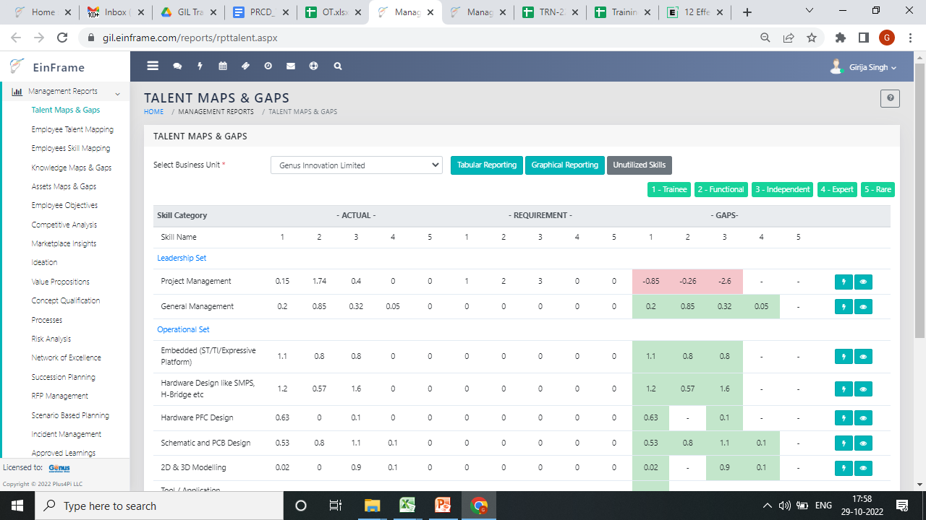
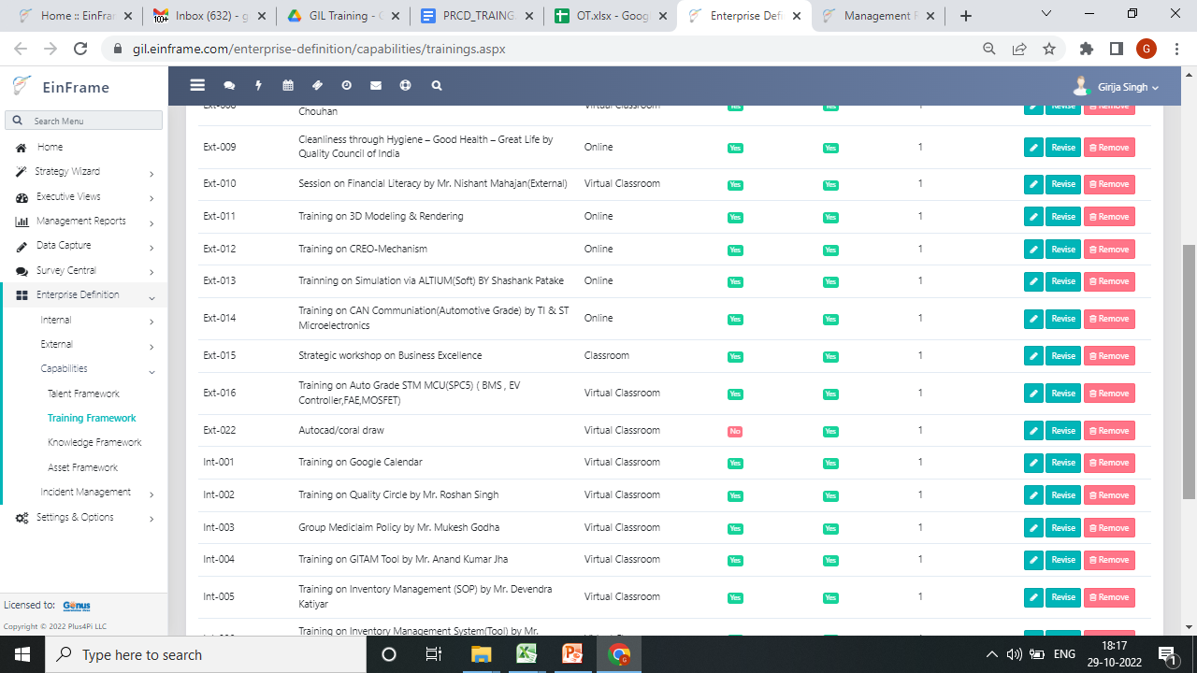
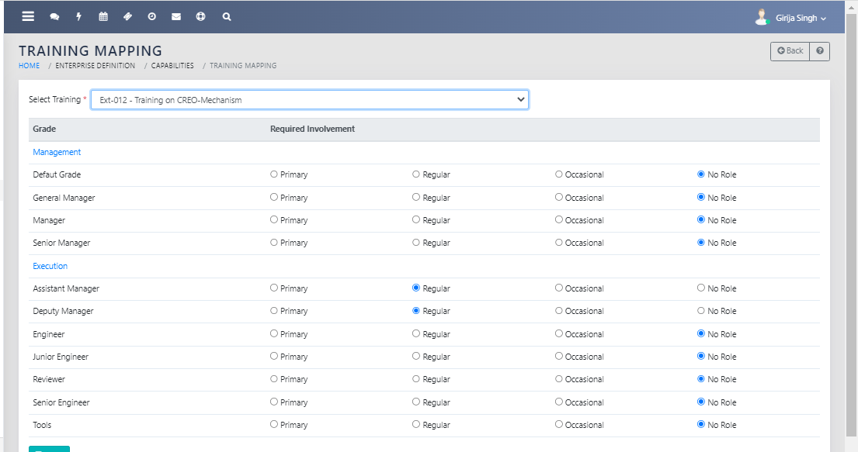
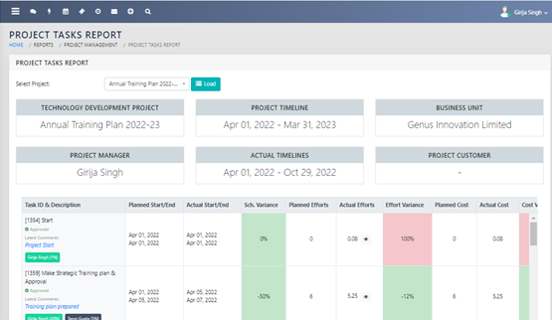
Identified Training Needs
Preparation of Strategic and Tactical Training yearly Plan
Training mapping
Project Task

Slide 4
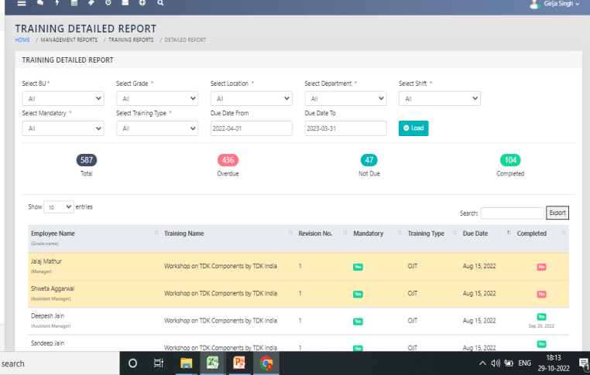
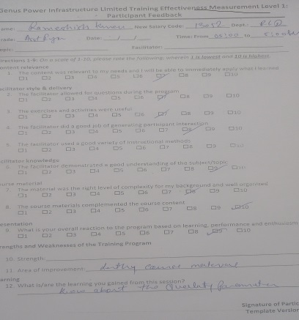
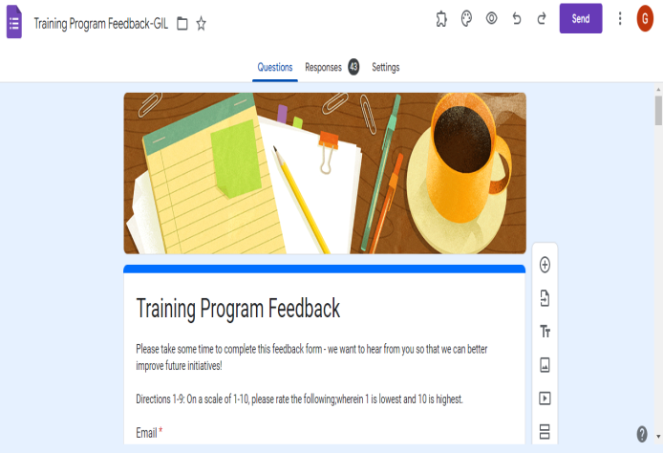
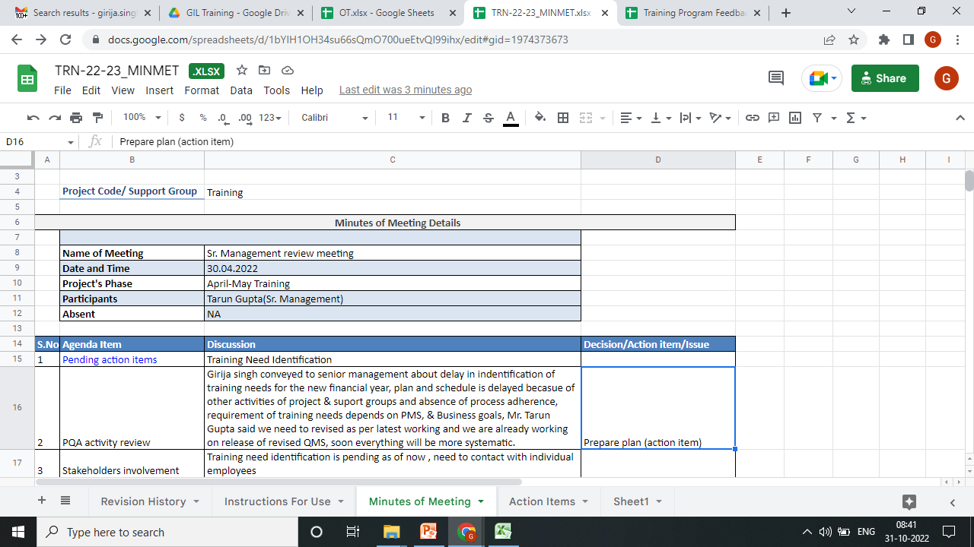
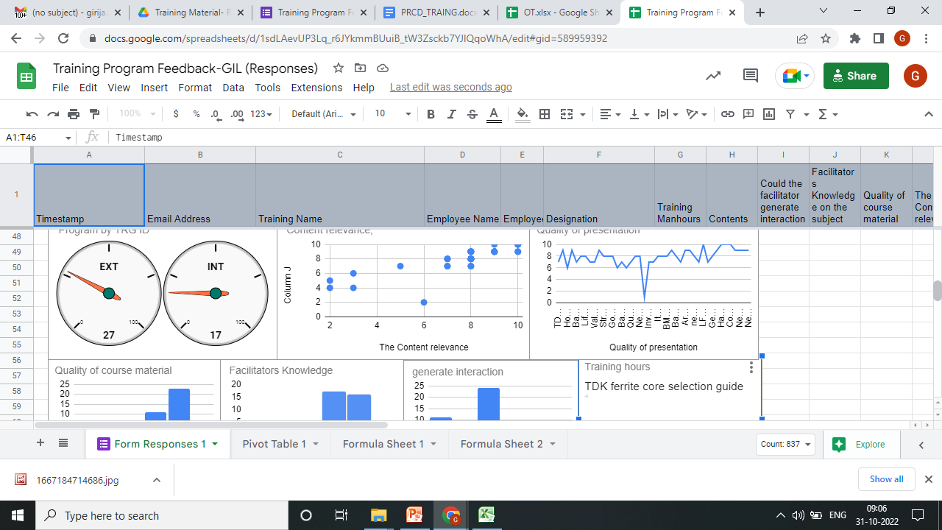
Training Detail Report
Earlier collected the feedback in hardcopy but after PQA evaluation we have design google form
Monthly meeting
Maintain Training Records and Analyse Feedbacks
Google Drive:- Video recording, ppt etc.

